Slide 1

DNN for time series- Preparing features and labels
Notes:
1

Slide 2
Objectives
Understand the preparing features and labels
Implement the code for Preparing features and labels
Preparing features and labels
2

Slide 3

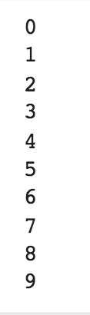
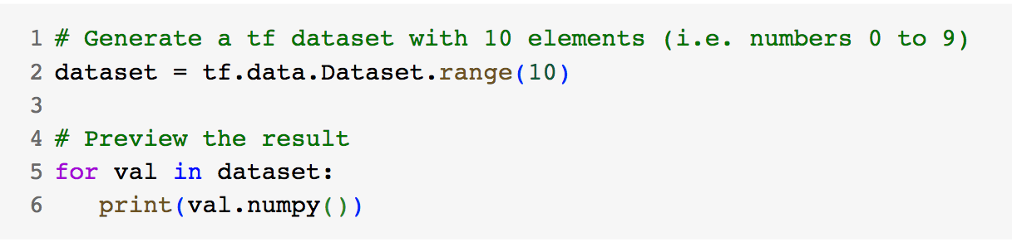
Preparing Time Series Features and Labels
Imports lib
Create a Simple Dataset
Preparing features and labels
3
Notes:
3

Slide 4
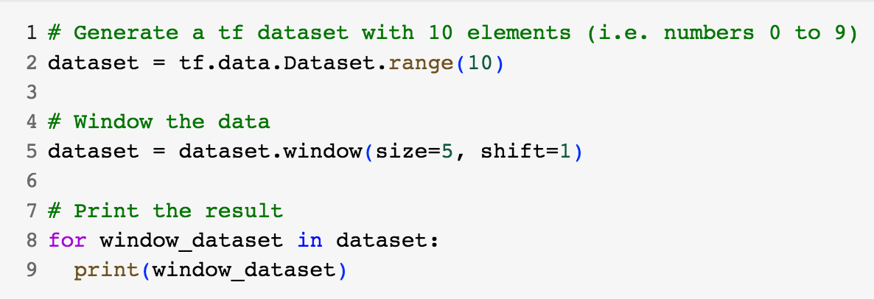
Preparing Time Series Features and Labels
Windowing the data
Preparing features and labels
4
Notes:
4

Slide 5
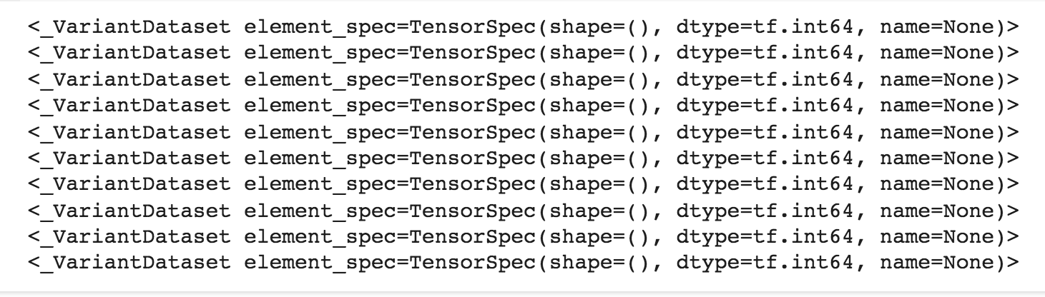
Preparing Time Series Features and Labels
Windowing the data: result of previous slide
Preparing features and labels
5
Notes:
5

Slide 6
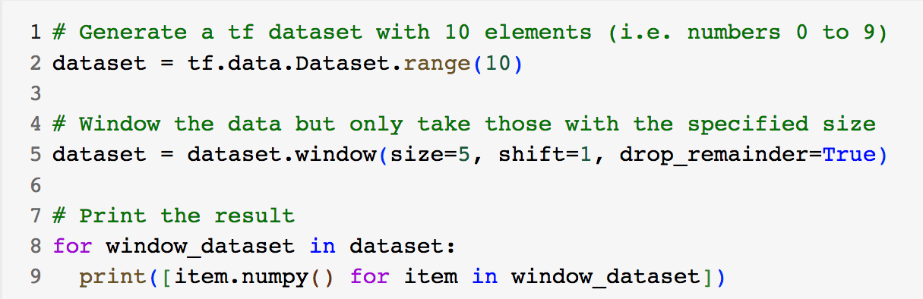
Preparing Time Series Features and Labels
Windowing the data
Result ?
Preparing features and labels
6
Notes:
6

Slide 7
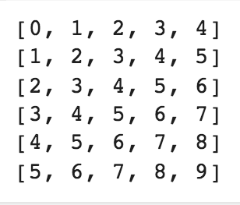
Preparing Time Series Features and Labels
Windowing the data
Preparing features and labels
7
Notes:
7

Slide 8
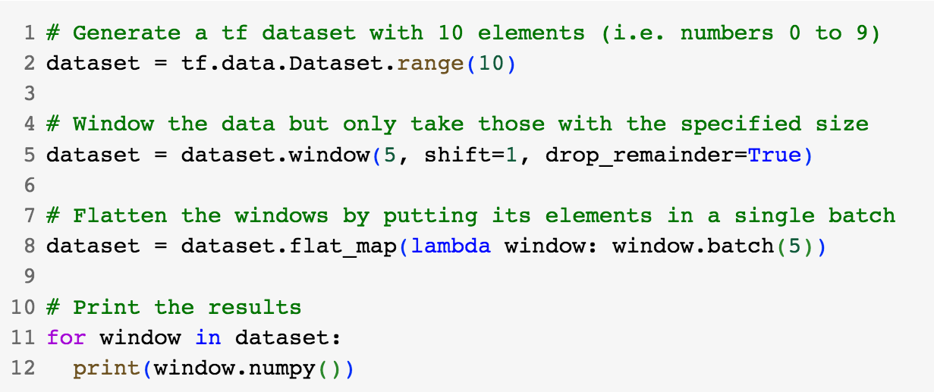
Preparing Time Series Features and Labels
Flatten the Windows
Result ?
Preparing features and labels
8
Notes:
8

Slide 9
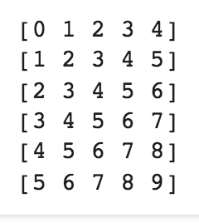
Preparing Time Series Features and Labels
Flatten the Windows
Preparing features and labels
9
Notes:
9

Slide 10
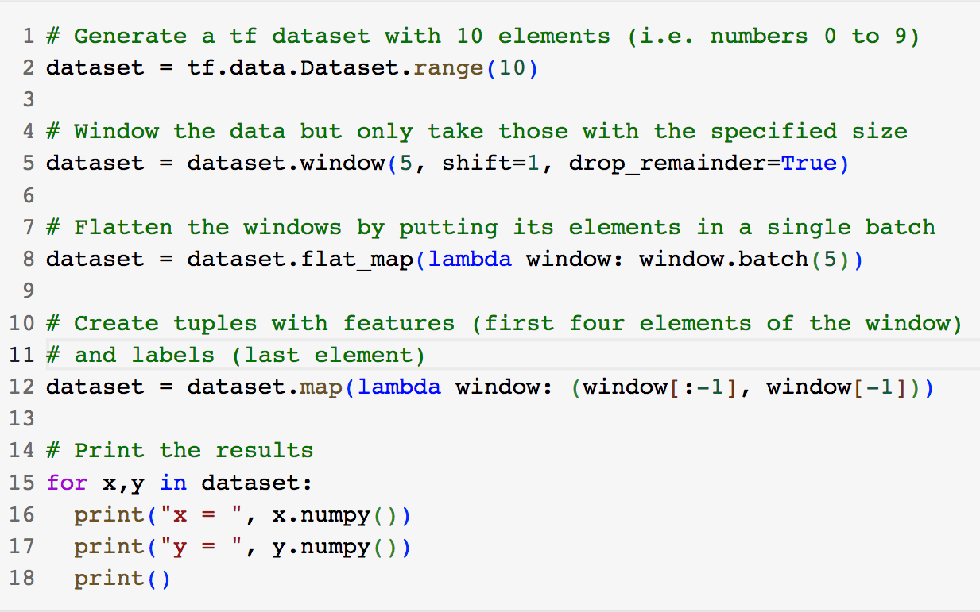
Preparing Time Series Features and Labels
Group into features and labels
Result ?
Preparing features and labels
10
Notes:
10

Slide 11
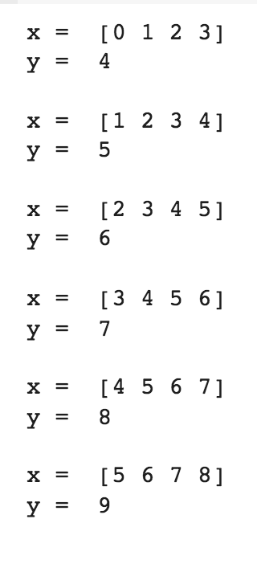
Preparing Time Series Features and Labels
Group into features and labels
Preparing features and labels
11
Notes:
11

Slide 12
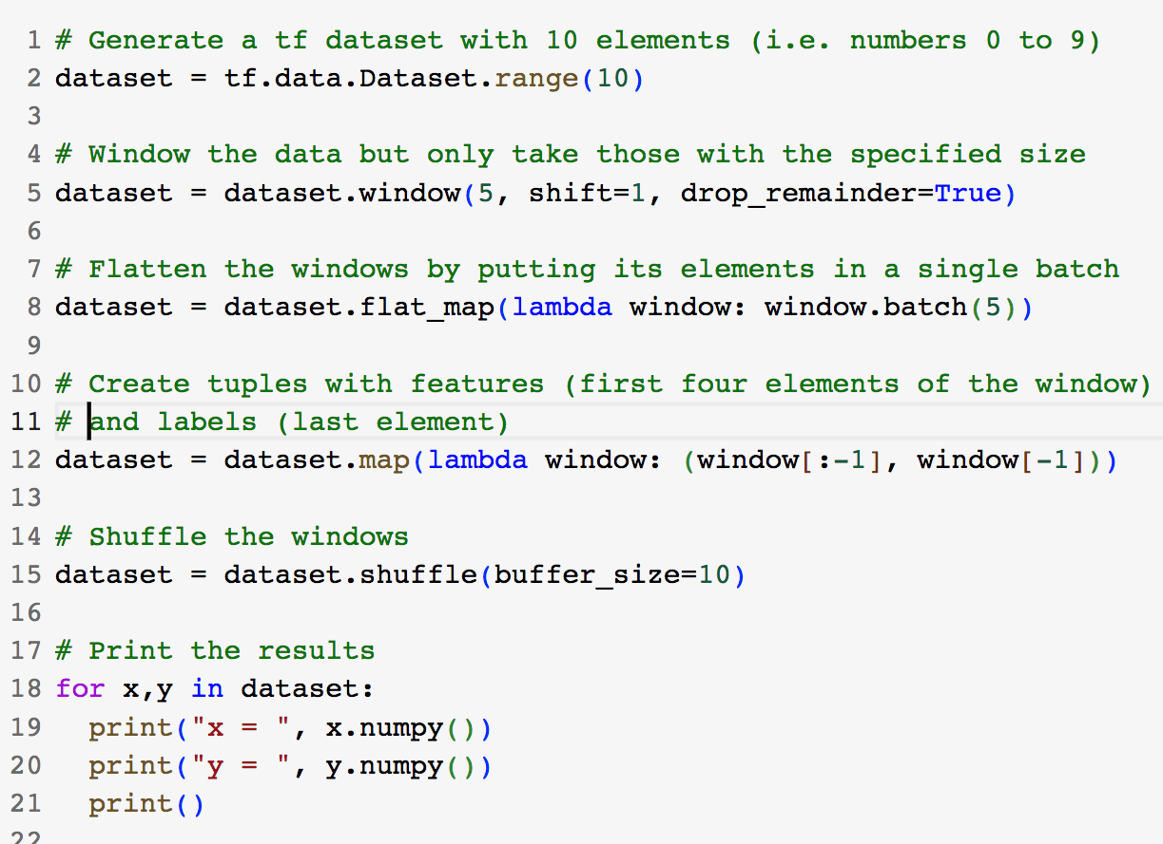
Preparing Time Series Features and Labels
Shuffle the data
Result ?
Preparing features and labels
12
Notes:
12

Slide 13
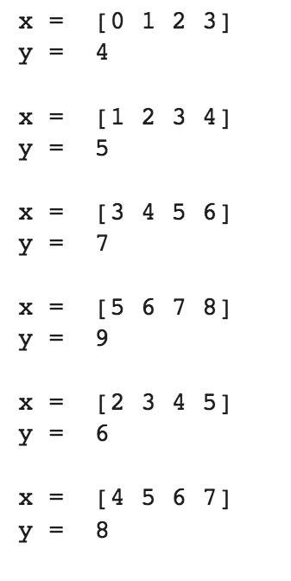
Preparing Time Series Features and Labels
Shuffle the data
Preparing features and labels
13
Notes:
13

Slide 14
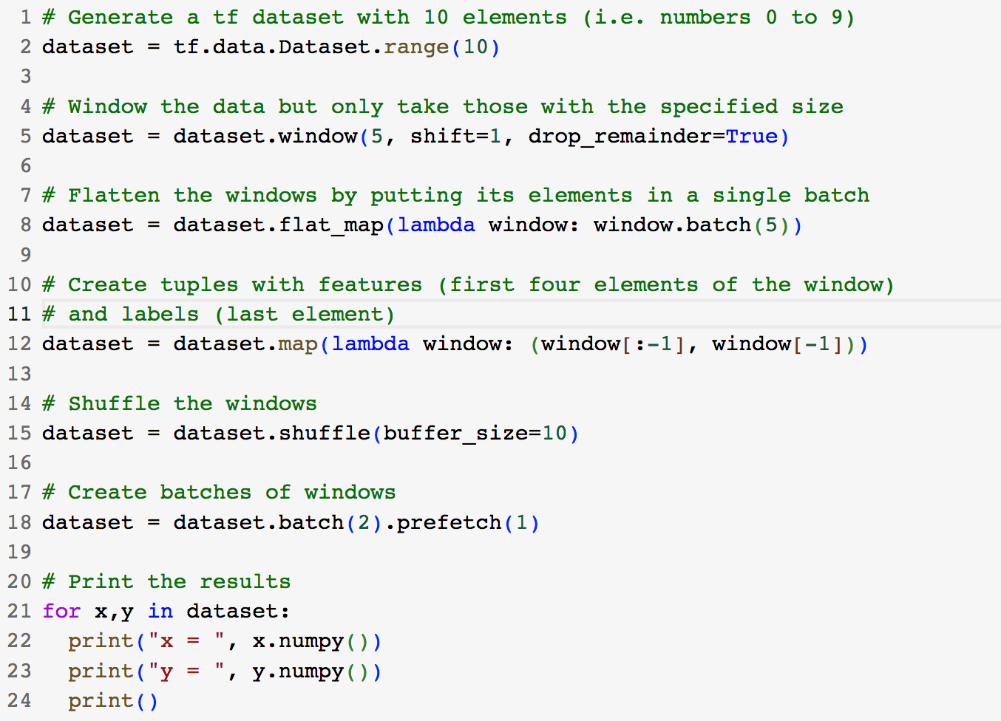
Preparing Time Series Features and Labels
Create batches for training
Result ?
Preparing features and labels
14
Notes:
14

Slide 15
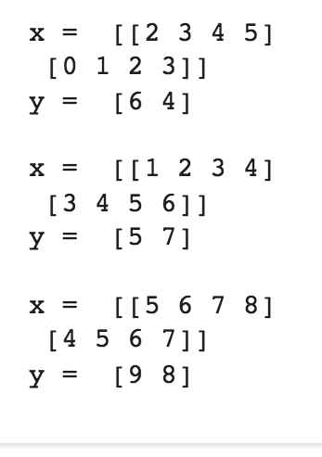
Preparing Time Series Features and Labels
Create batches for training
Preparing features and labels
15
Notes:
15

Slide 16
Summary
Understand the preparing features and labels
Implement the code for Preparing features and labels
Preparing features and labels
16

Slide 17
Q & A
Preparing features and labels
17

